Slide 1

Skin Lesion Analysis Towards Melanoma Detection
Dwarkanath Prabhu
Directed Studies Update
Nov 16, 2018

Slide 2
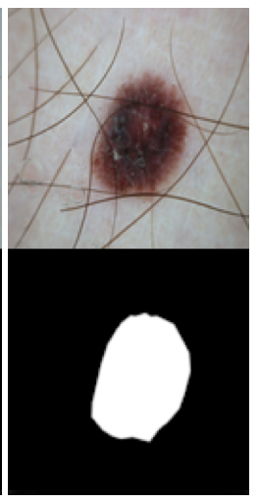
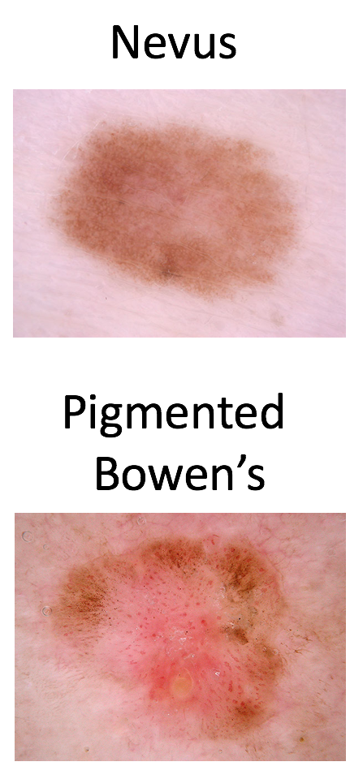
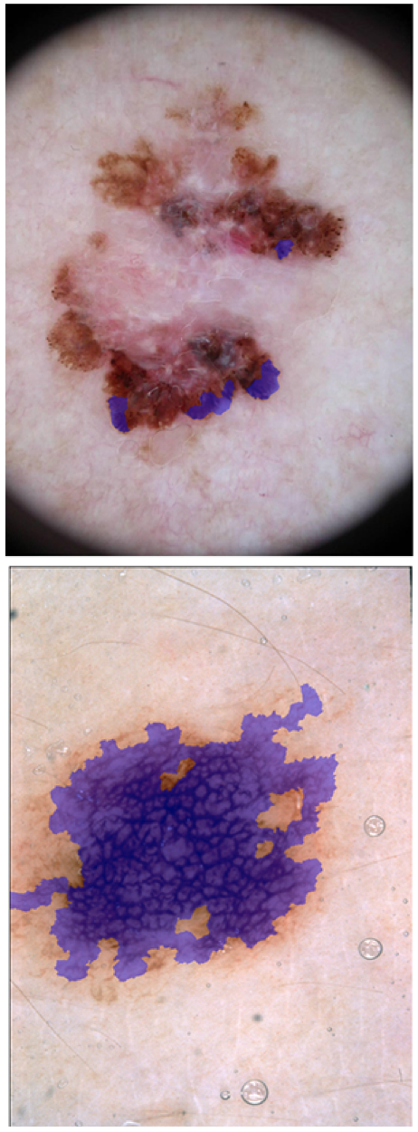
ISIC Challenge Tasks
Task 1: Lesion Boundary
Segmentation
Task 2: Lesion Attribute
Detection
Task 3: Lesion Diagnosis
Working on Tasks 1 and 3

Slide 3
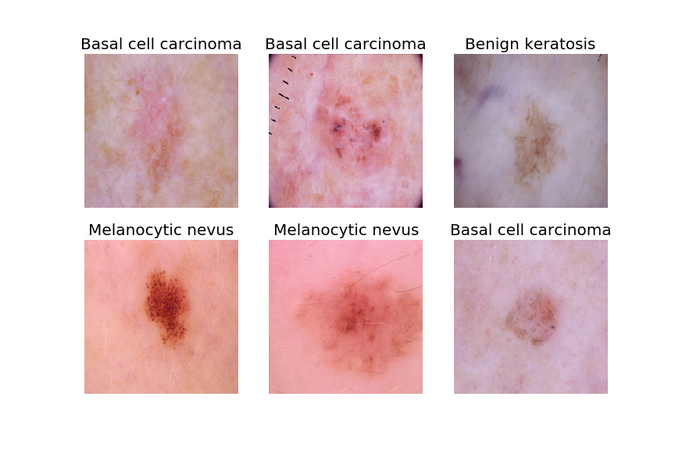
Task 3 Dataset
There are 10,015 images in the labeled training dataset
Some sample images from the dataset and their labels are shown on the right
The labels are in a CSV file in the form of one-hot vectors
There are no missing labels and all images are classified into one of 7 classes:
Melanoma
Melanocytic nevus
Basal cell carcinoma
Actinic keratosis / Bowen’s disease (intraepithelial carcinoma)
Benign keratosis (solar lentigo / seborrheic keratosis / lichen planus-like keratosis)
Dermatofibroma
Vascular lesion

Slide 4
Image Preprocessing and Training
Load Images and Resize
The images are of all size 600x450
In order to use a pretrained model, trained on ImageNet data the images needed to be resized to ImageNet input dimensions i.e 224 x 224
Data Augmentation
Created mirror images of all images to double the dataset
Labels were kept constant
Make training and validation sets
To test the model 10% of the training set (~1000 images) was withheld to make a validation set
Choice of hyperparameters (number of epochs, learning rate etc.) will be based on model performance on the validation set
Testing with a small pretrained model
Trained the last layer of a small VGG19 model with pretrained weights on a sample of the dataset (20%)
Achieved 70% accuracy but the dataset is heavily imbalanced

Slide 5
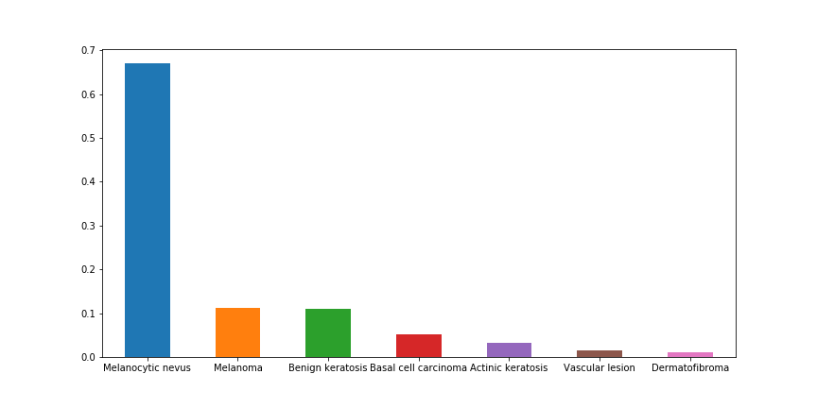
Correcting Class Imbalance
Approximately 70% of the images belong to only one class (Melanocytic nevus)
Hence, 70% accuracy can be achieved simply by predicted all images to be of that class
Possible corrections:
Change loss function to be weighted by classes i.e. penalize the dominating class
Use a bigger model with skip connections (ResNet)
Oversample images of less frequent classes

Slide 6
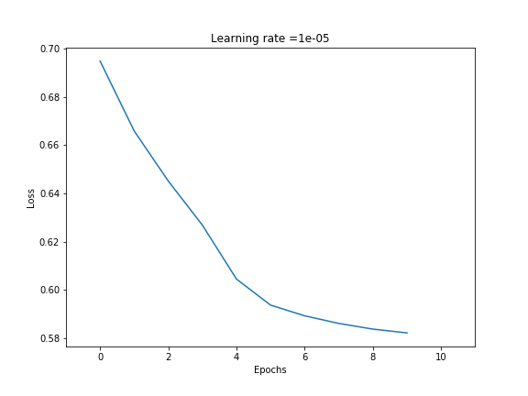
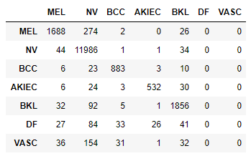
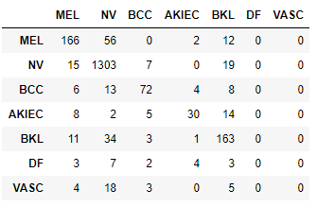
Results From Using ResNet50
Training Loss
Training Confusion Matrix
Validation Confusion Matrix
Metric | Training | Validation
Accuracy | 93.99% | 86.57%
Precision | 92.92% | 78.61%
Recall | 66.07% | 52.13%
F1 Score | 77.22% | 62.69%

Slide 7
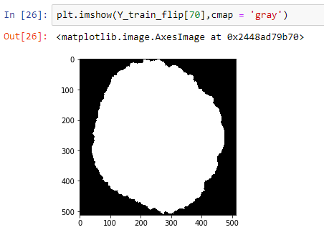
Next Steps and Other Tasks
Task 3 Next Steps:
Oversampling of low frequency classes to correct class imbalance
Tune hyperparameters to achieve benchmark
Try ensemble models
Save trained model to file for quicker predictions
Task 1 update:
Load and resize images and labels to 512x512
Define evaluation metric – Jaccard Index
Flip images and labels for data augmentation
Task 1 Next Steps:
Train CNN for lesion boundary segmentation
Try random cropping and color correction for data augmentation

Slide 8
Thank You

